Slide 1
THE FIRST REPORT 12/11/2022
ĐẶNG THỊ THANH HUYỀN
Advanced Program Biomedical Engineering K66

Slide 2
2 PARTS
COURSES THAT I HAVE LEARNED
MY PLAN

Slide 3
COURSES
Introduction to Python

Slide 4
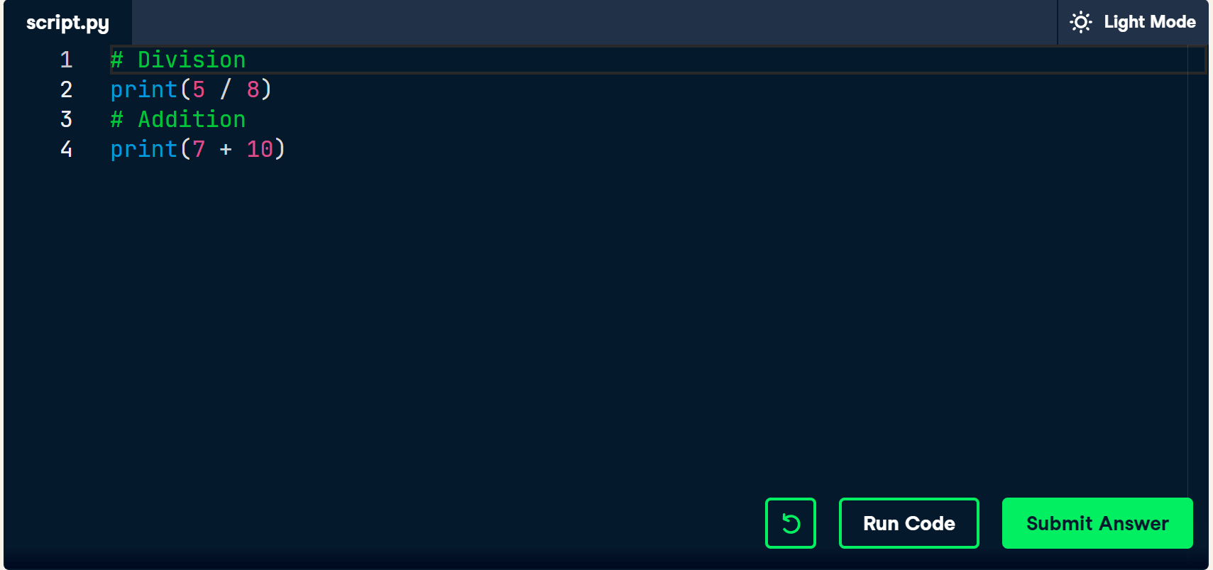
Applications
1.Quick Calculations
2.Develop a Database-driven Website
3.Clean and Analyze Results Of The Latest Satisfaction Survey
Comments
Use tag #

Slide 5
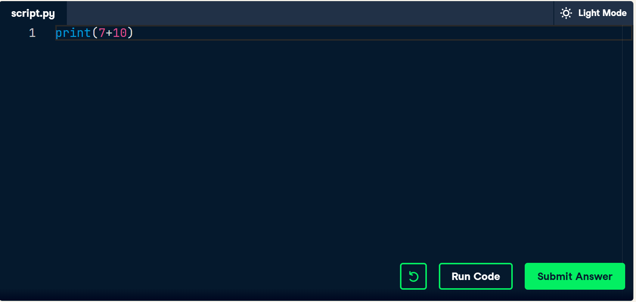
Python script
Must be: .py (script.py)

Slide 6
Calculations
1.Exponentiation: **
Raises the number to its left to the power of the number to its right
For example 4**2 will give 16.
2.Modulo: %.
Remainder of the division of the number to the left by the number on its right.
For example 18 % 7 equals 4.

Slide 7
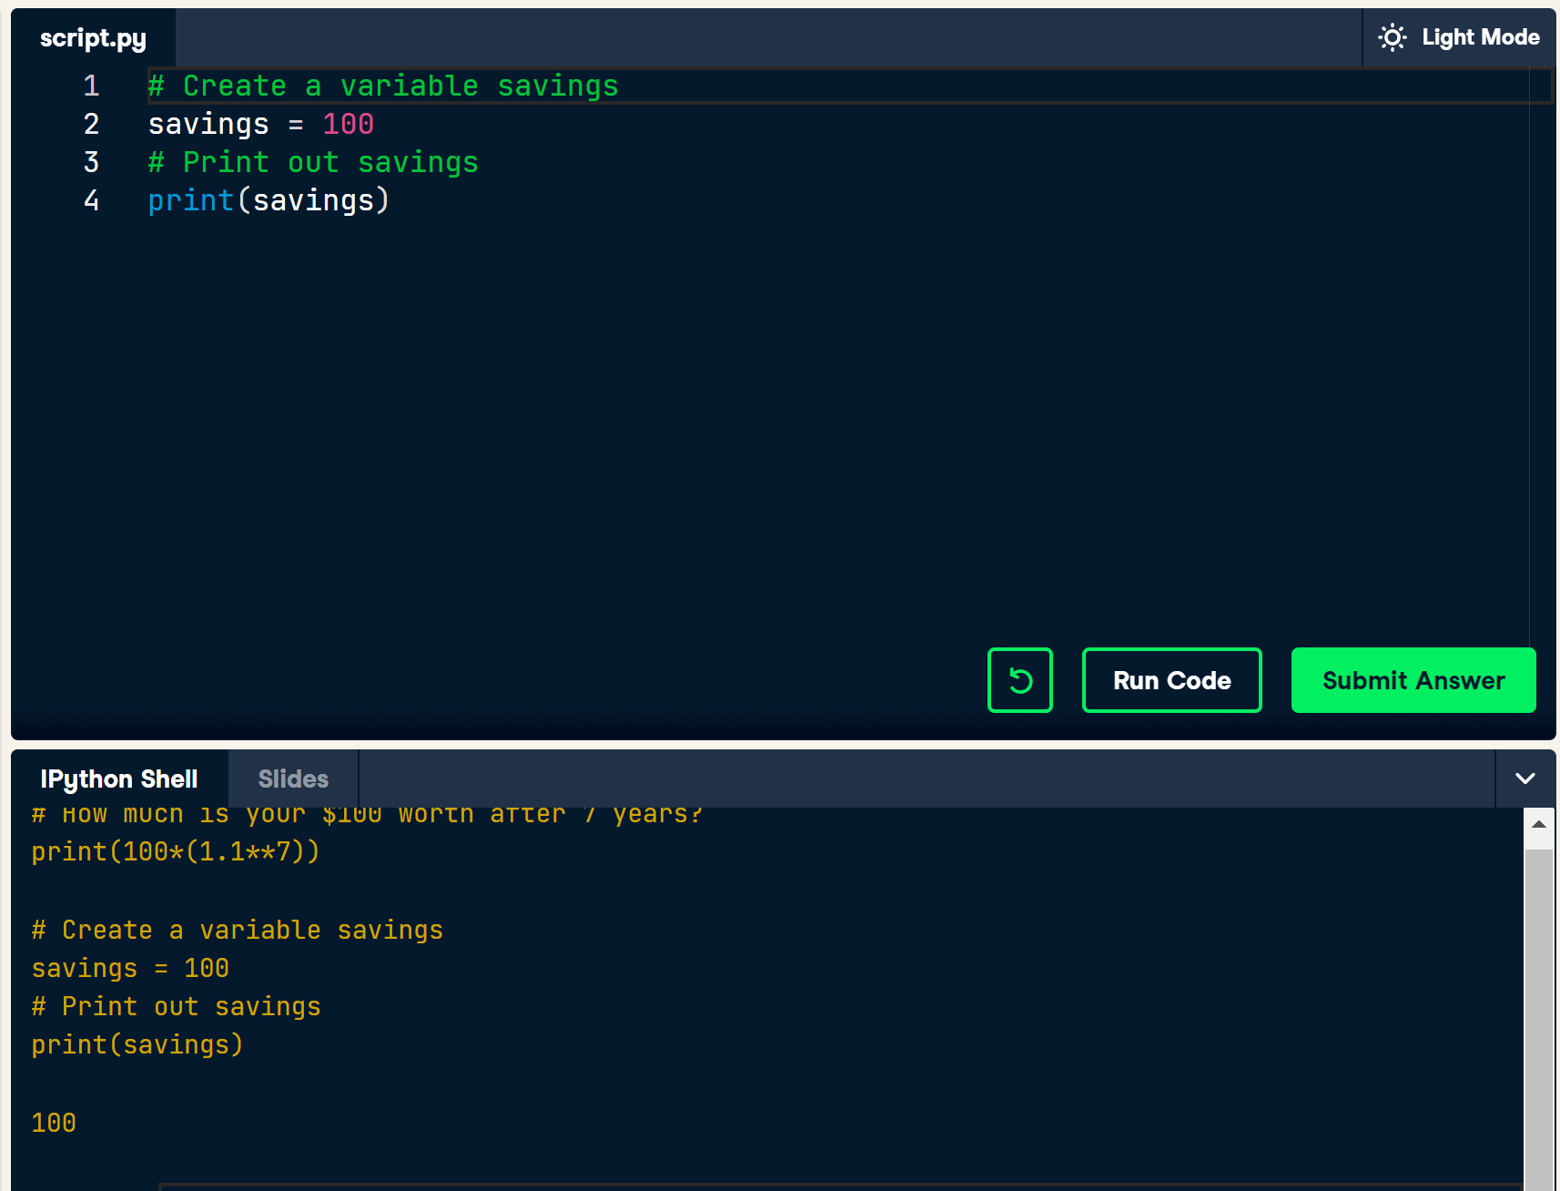
Variable
Use “=“
Assignment, not test equality
Instead of actual values

Slide 8
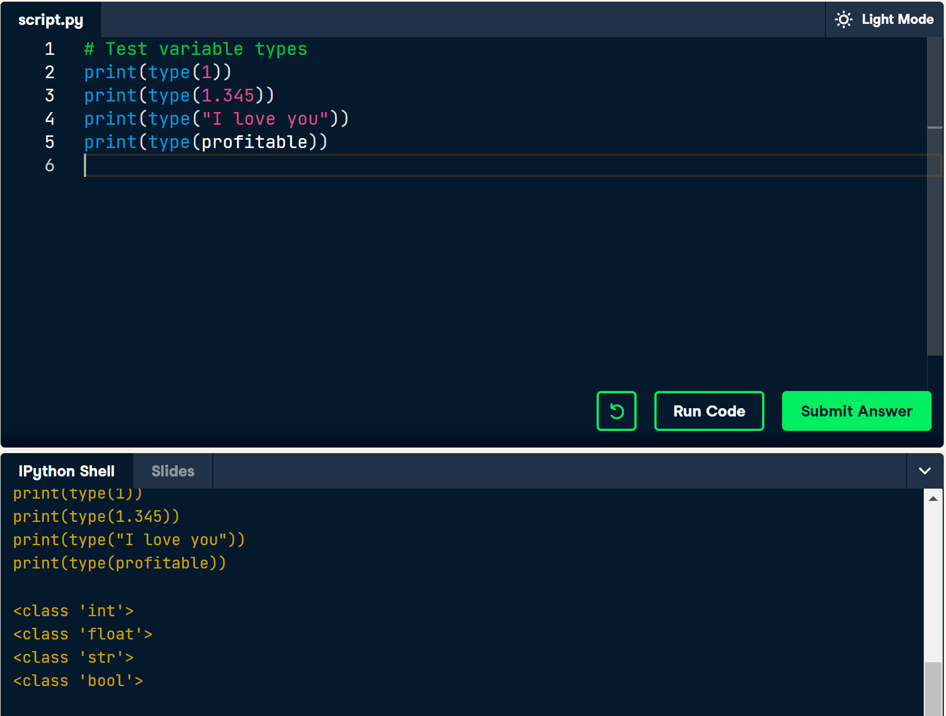
Variable types
int (integer): without a fractional part
float: both an integer and fractional part
str (string): text. Single or double quotes
bool (boolean): logicals values (True or False)
Watch out: Cannot simply sum strings and integers/floats.

Slide 9
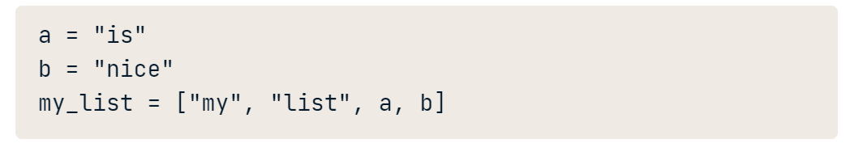
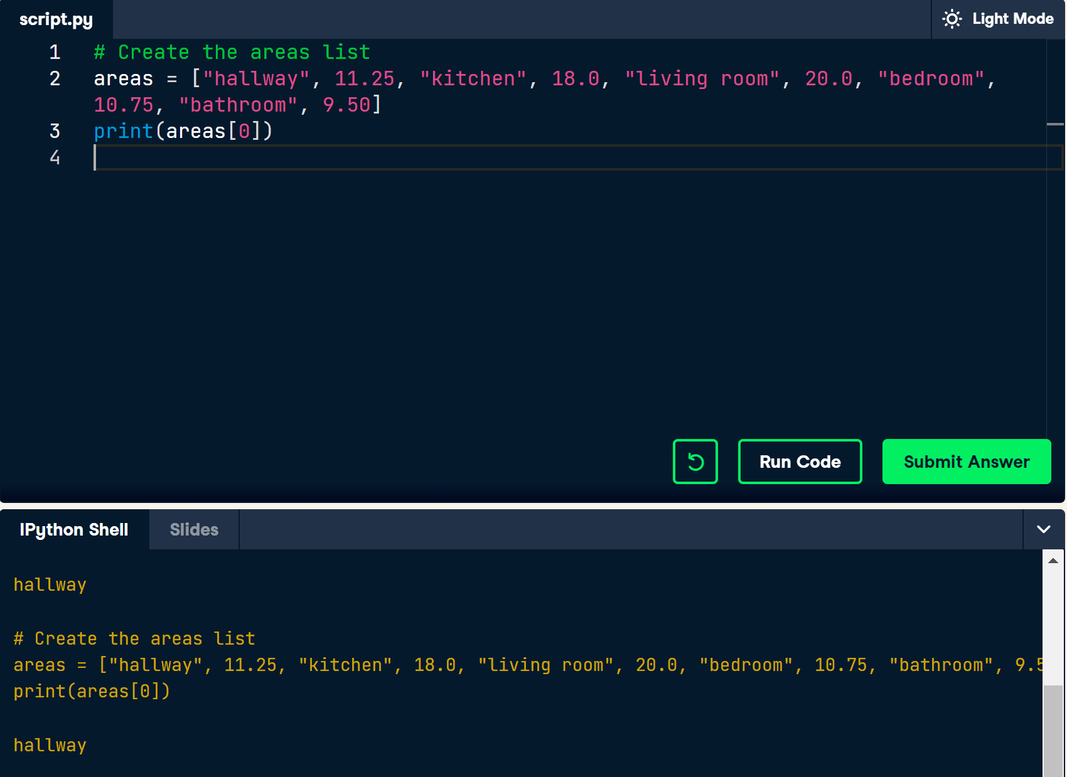
Lists
Compound data type
Subset
index start from 0

Slide 10
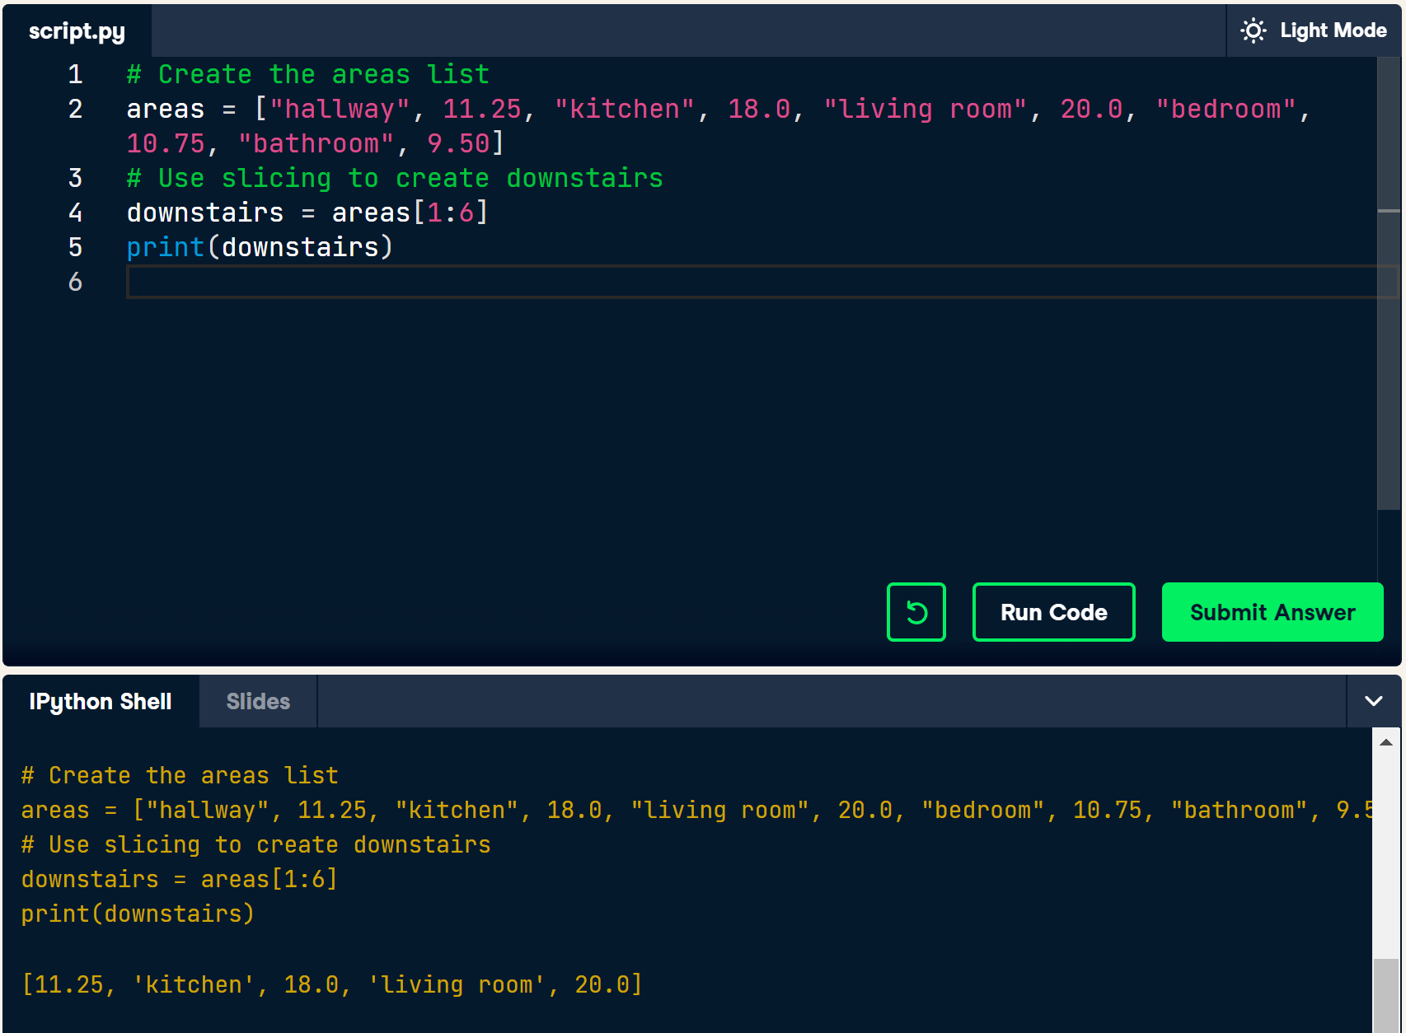
Slicing
list [start : end]
result: from start to (end – 1)

Slide 11
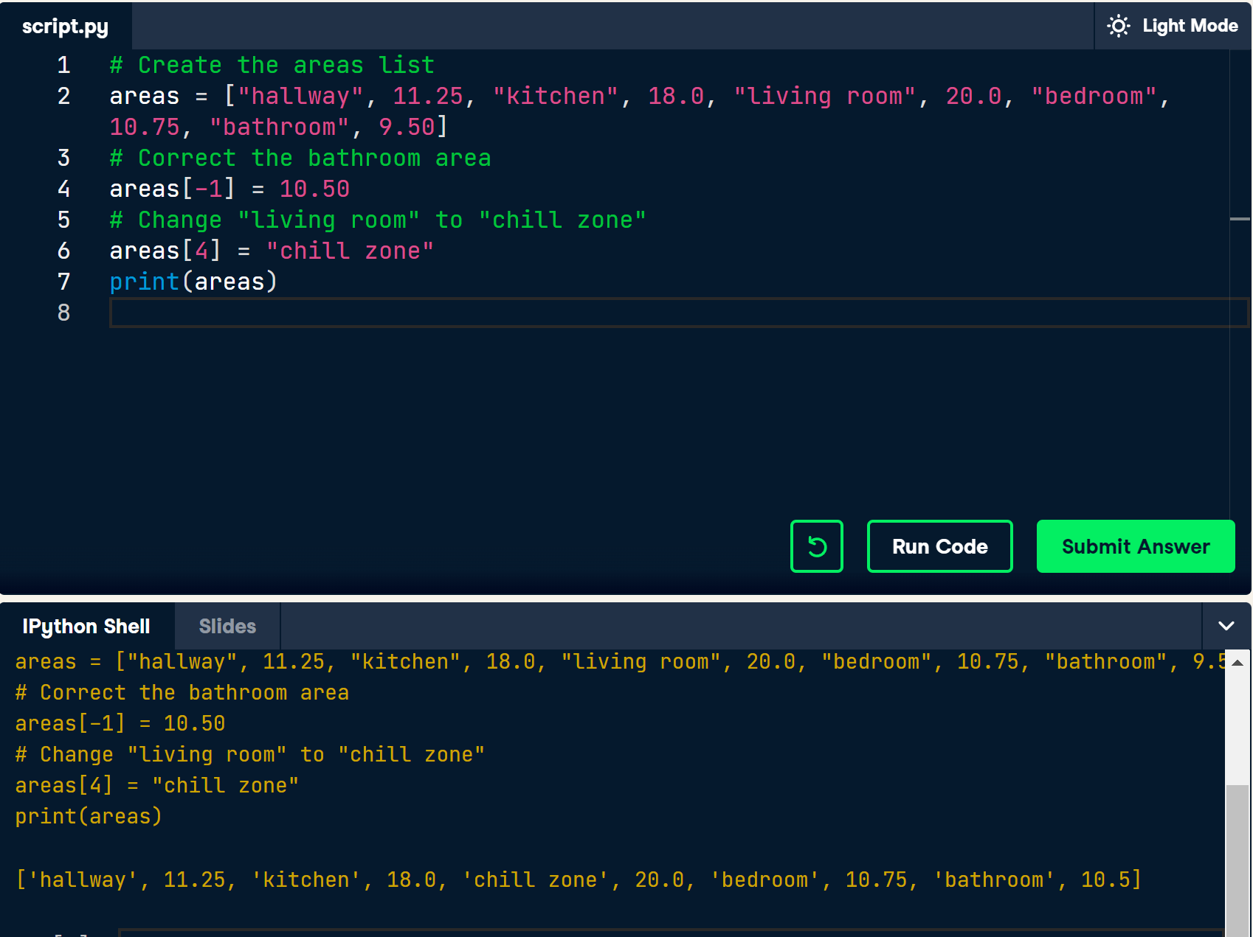
Replace list elements
select single elements
change entire list slices at once

Slide 12
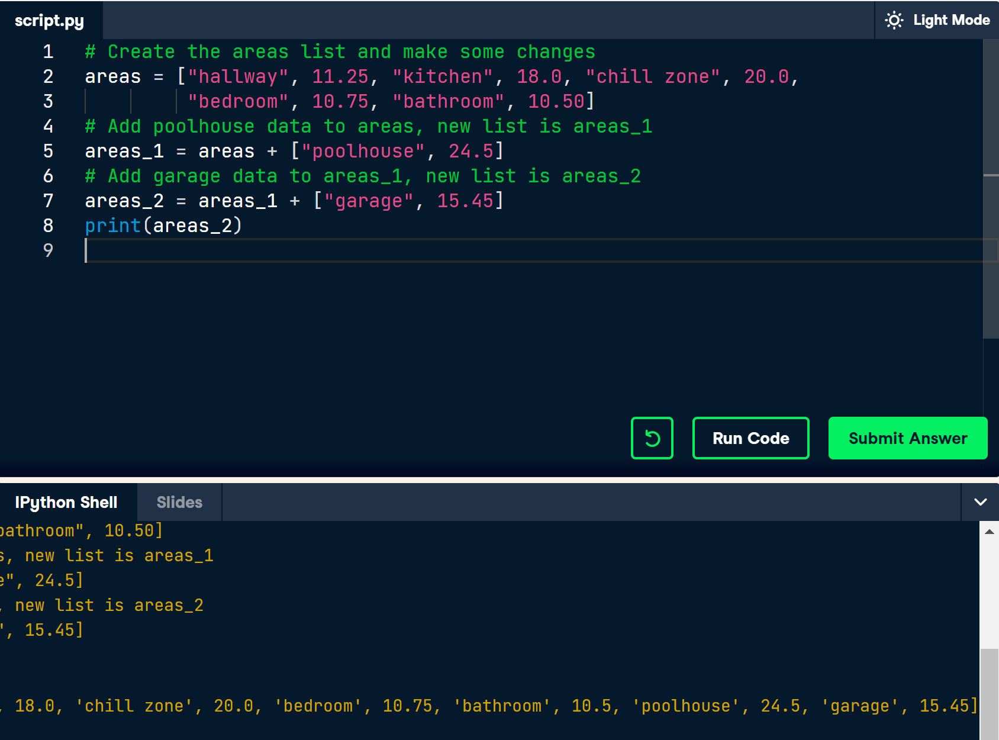
Extend
use “+” operator

Slide 13
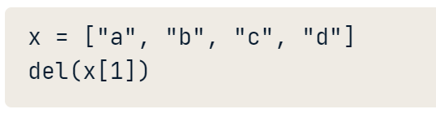
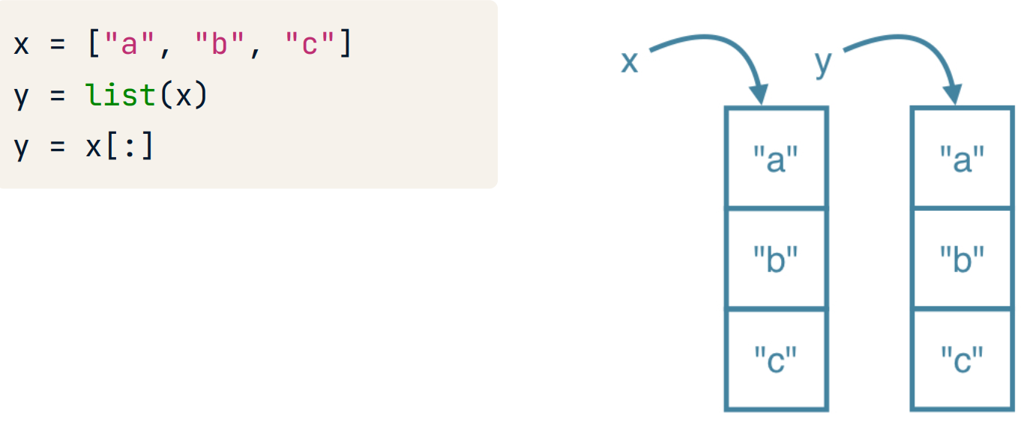
Delete
Copy
“del”
del(list[index])
y = list (x)
y = x [:]

Slide 14
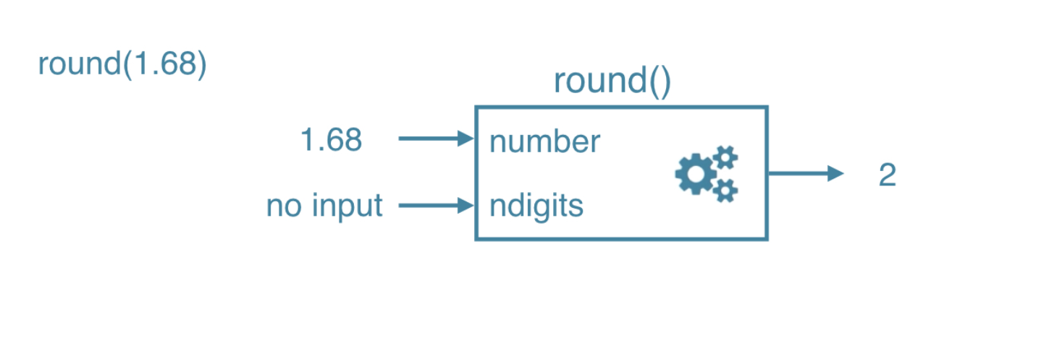
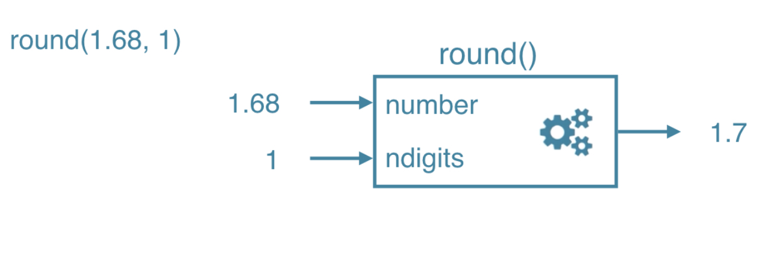
Functions
round()
round(number)
round(number, ndigits)

Slide 15
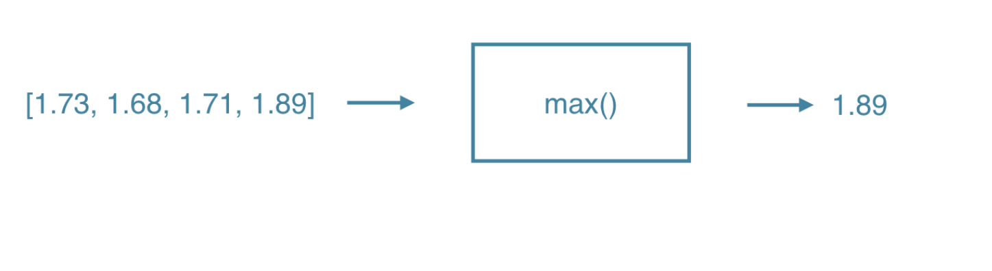
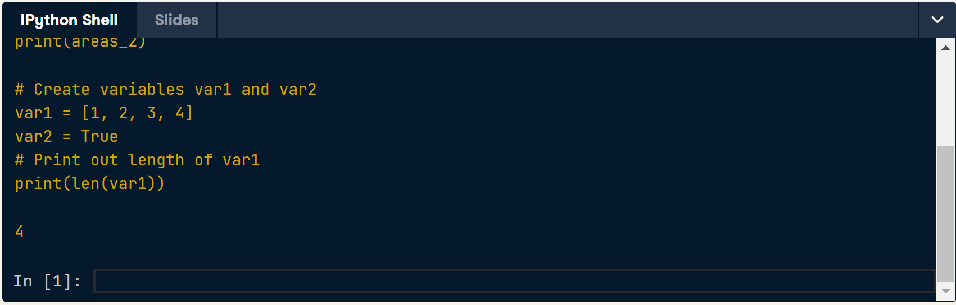
Functions
max()
max(list)
len()
length of list
len(list)

Slide 16
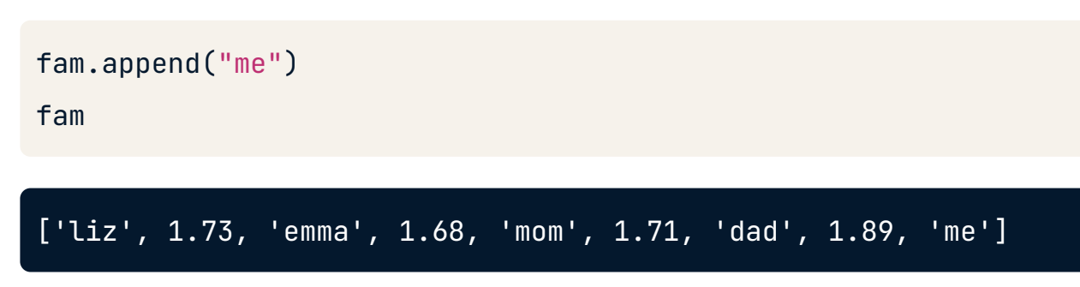
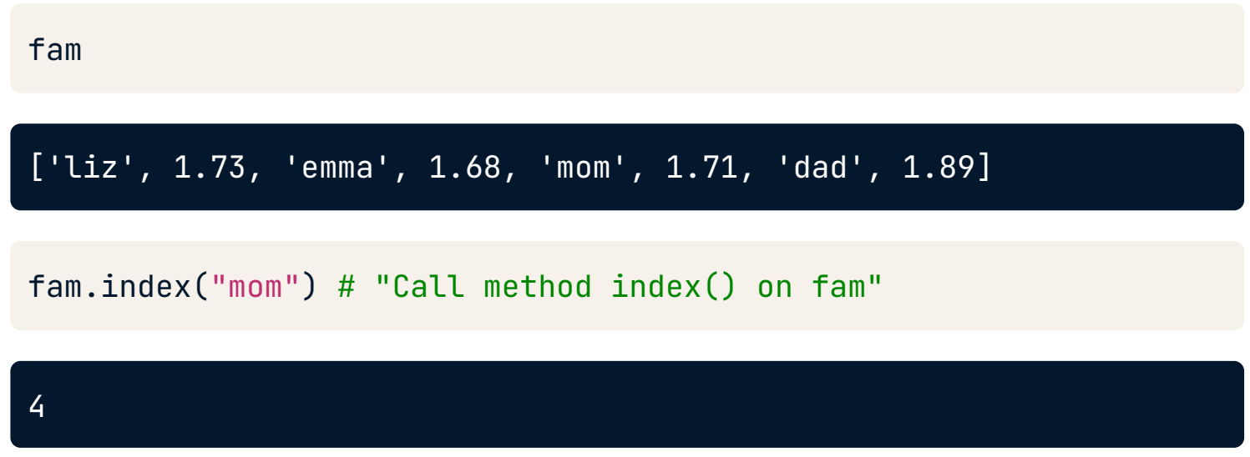
Methods
list.index()
list.count(): the number of times an element appears
list.capitalize()
list.replace()
list.append(): adds an element
list.remove()
list.reverse(): reverses the order

Slide 17
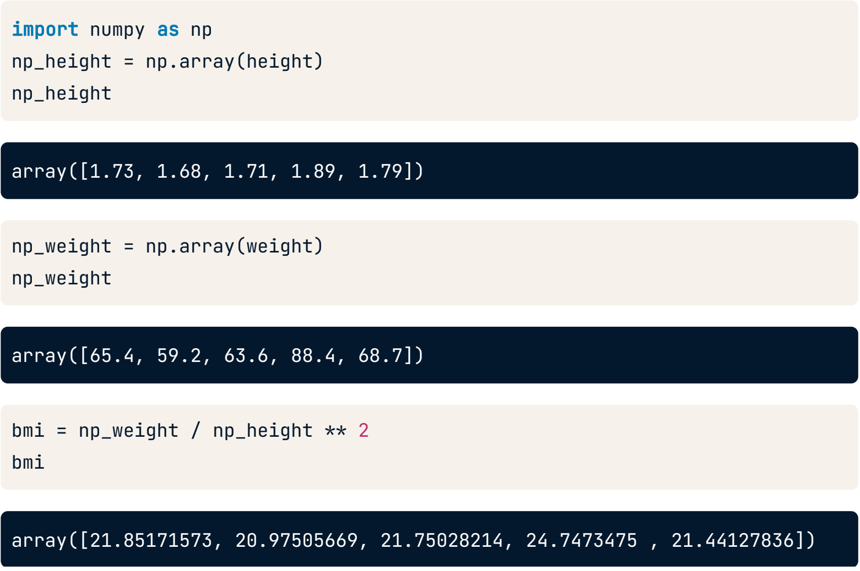
NumPy
1. Alternative to Python List: NumPy Array 2. Calculations over entire arrays 3. Easy and Fast
import numpy as np
np_list = np.array(list)
NumPy arrays contain only one type

Slide 18
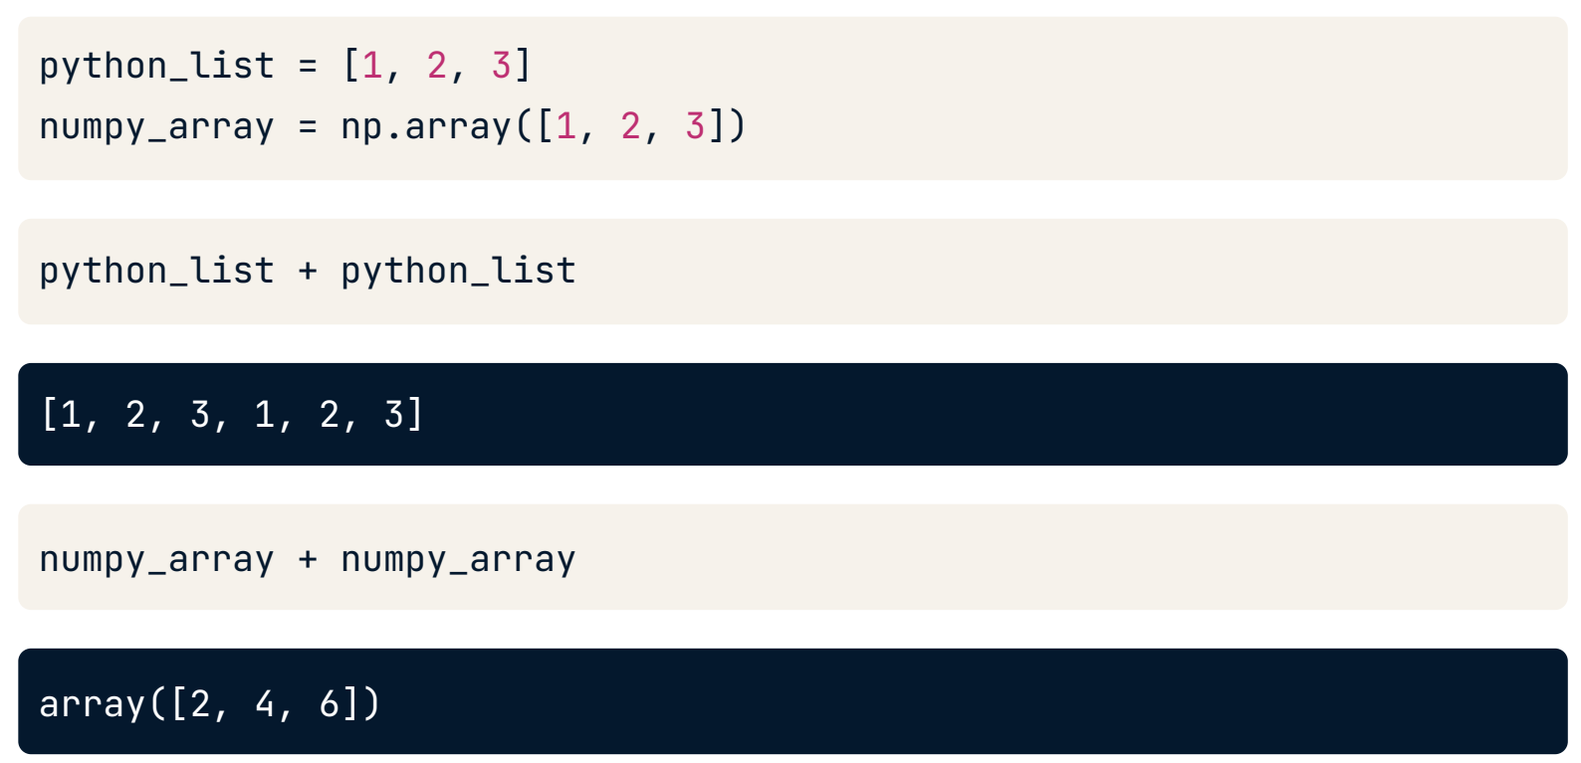
Different types = different behavior

Slide 19
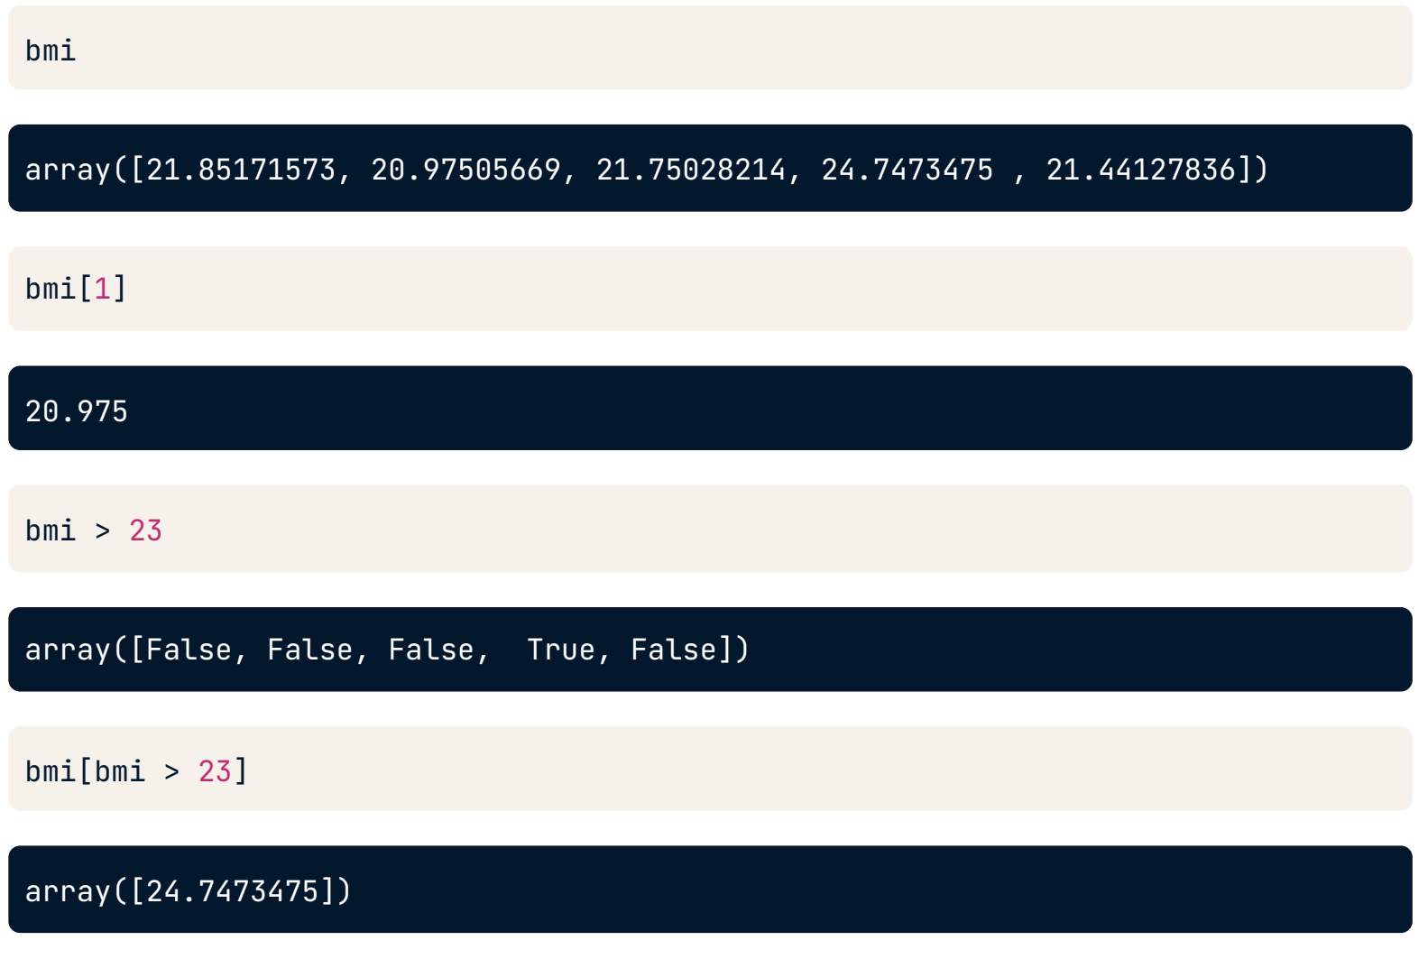
Subsetting

Slide 20
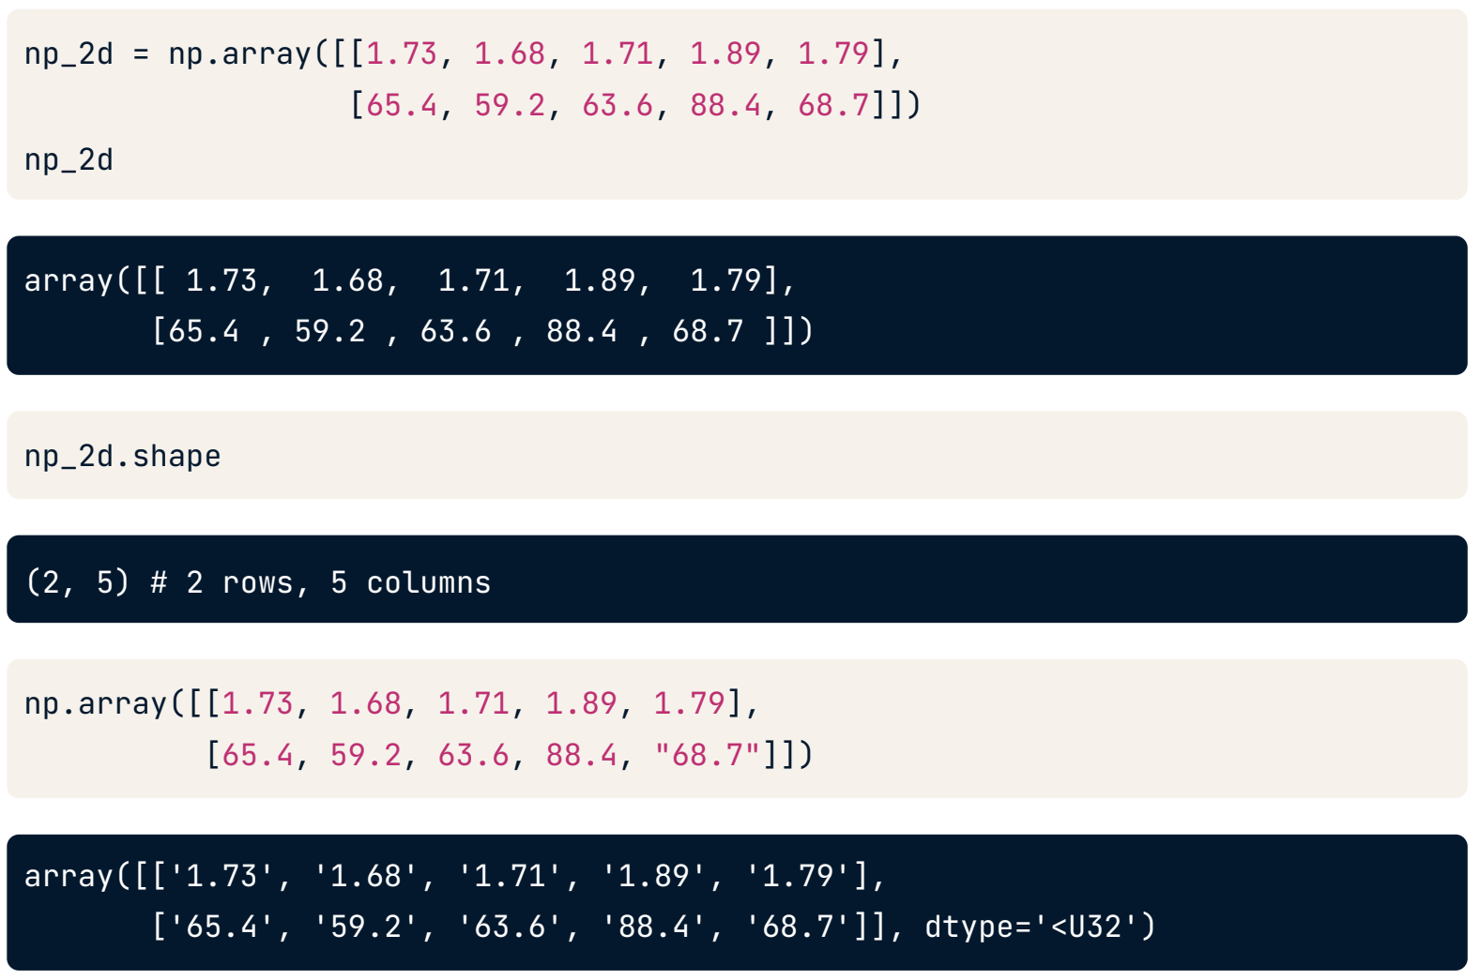
2D NumPy Arrays

Slide 21
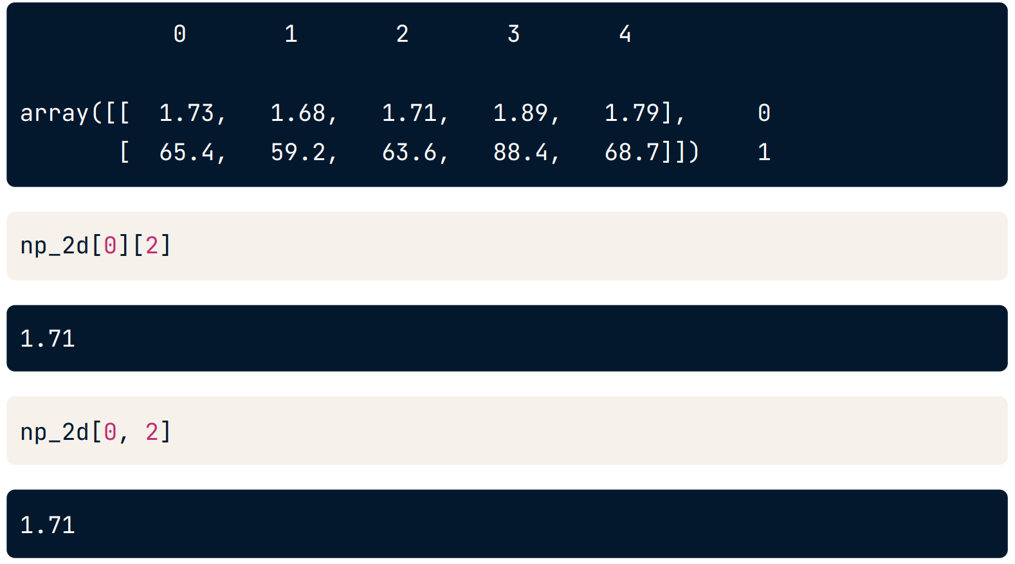
Subsetting

Slide 22
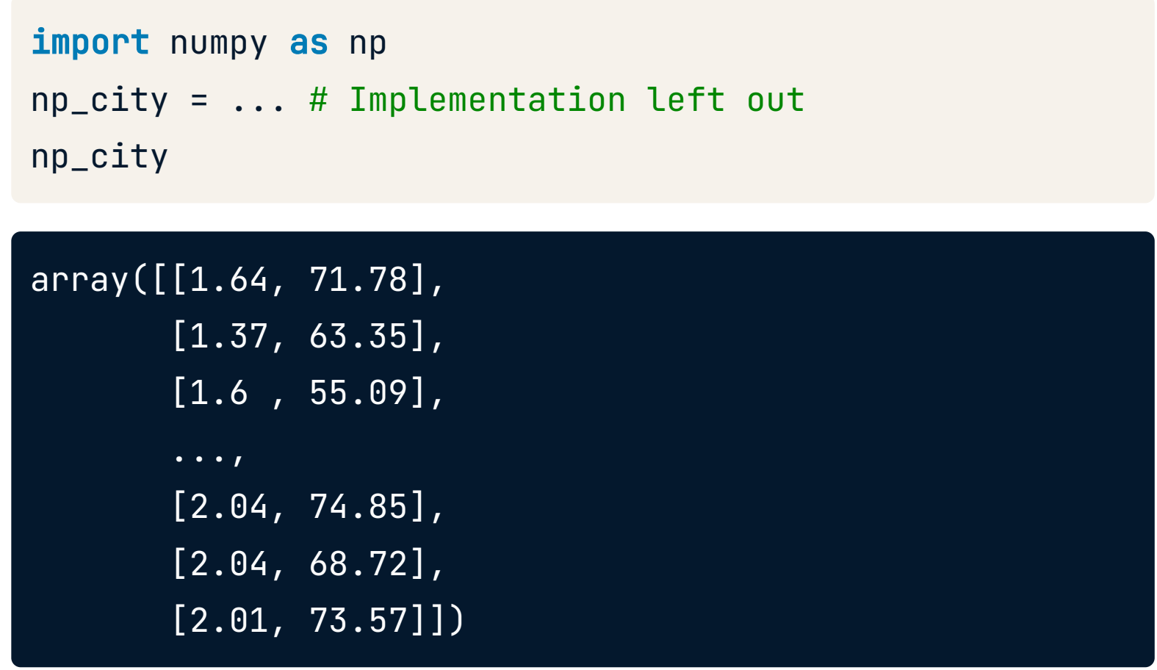
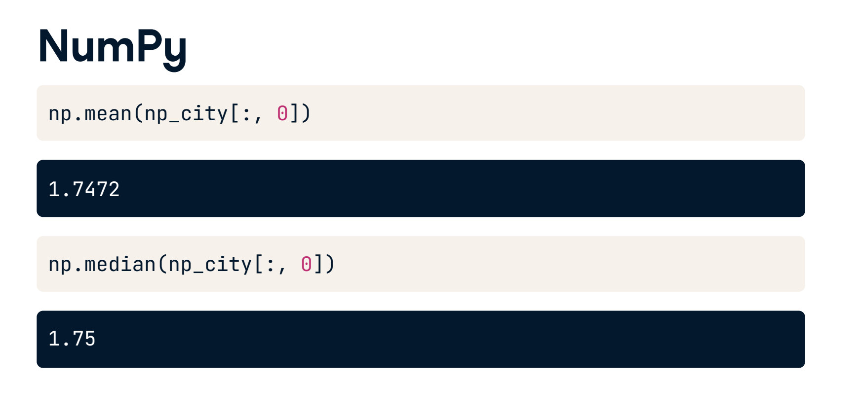
Data Analysis

Slide 23
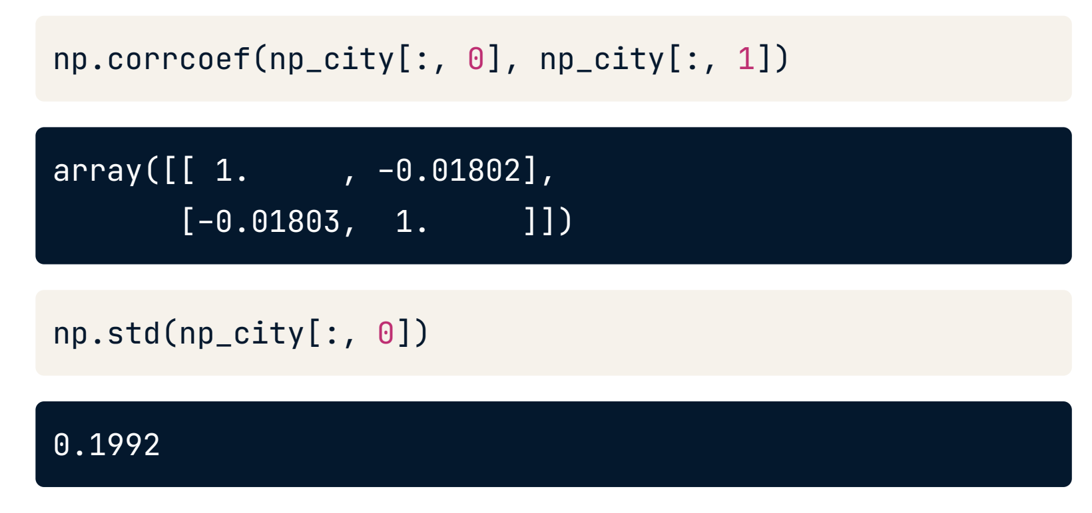
Data Analysis

Slide 24
PLAN

Slide 25
MY PLAN
1
2
3
4
Python OOP
Pandas – Data Manipulation : Data Manipulation + Joining Data
Complete intermediate Python
NumPy

Slide 26
Thank you for your listening

